Slide 1
CyberTronics Security Solutions
- Web Development Project

Slide 2
TABLE OF CONTENTS
01
03
About the Project
Sneak Peek
02
04
Major Featues
Our Team
Description of the project
A look at the website design and UI
Features of the Website
Meet with our experts

Slide 3
ABOUT THE PROJECT
We Have Developed a web application (Front-End only) Of a Professional IT services company which provide different types of services.

Slide 4
Technology Used
HTML
CSS
JAVASCRIPT

Slide 5
Features
Layout
USER EXPERIENCE
Responsiveness
SEO
An attractive and accurate layout that will attract the user and make them spend a lot of time on the website.
Simple and Attractive UI Makes the user Experience amazing
Responsiveness is the ability for a website to adapt the disposal of its content according to the reader’s device.
SEO is the thing you must do to improve your ranking in search engines such as Google, Bing, DuckDuckGo, and so on. It increases your visibility on the web.

Slide 6
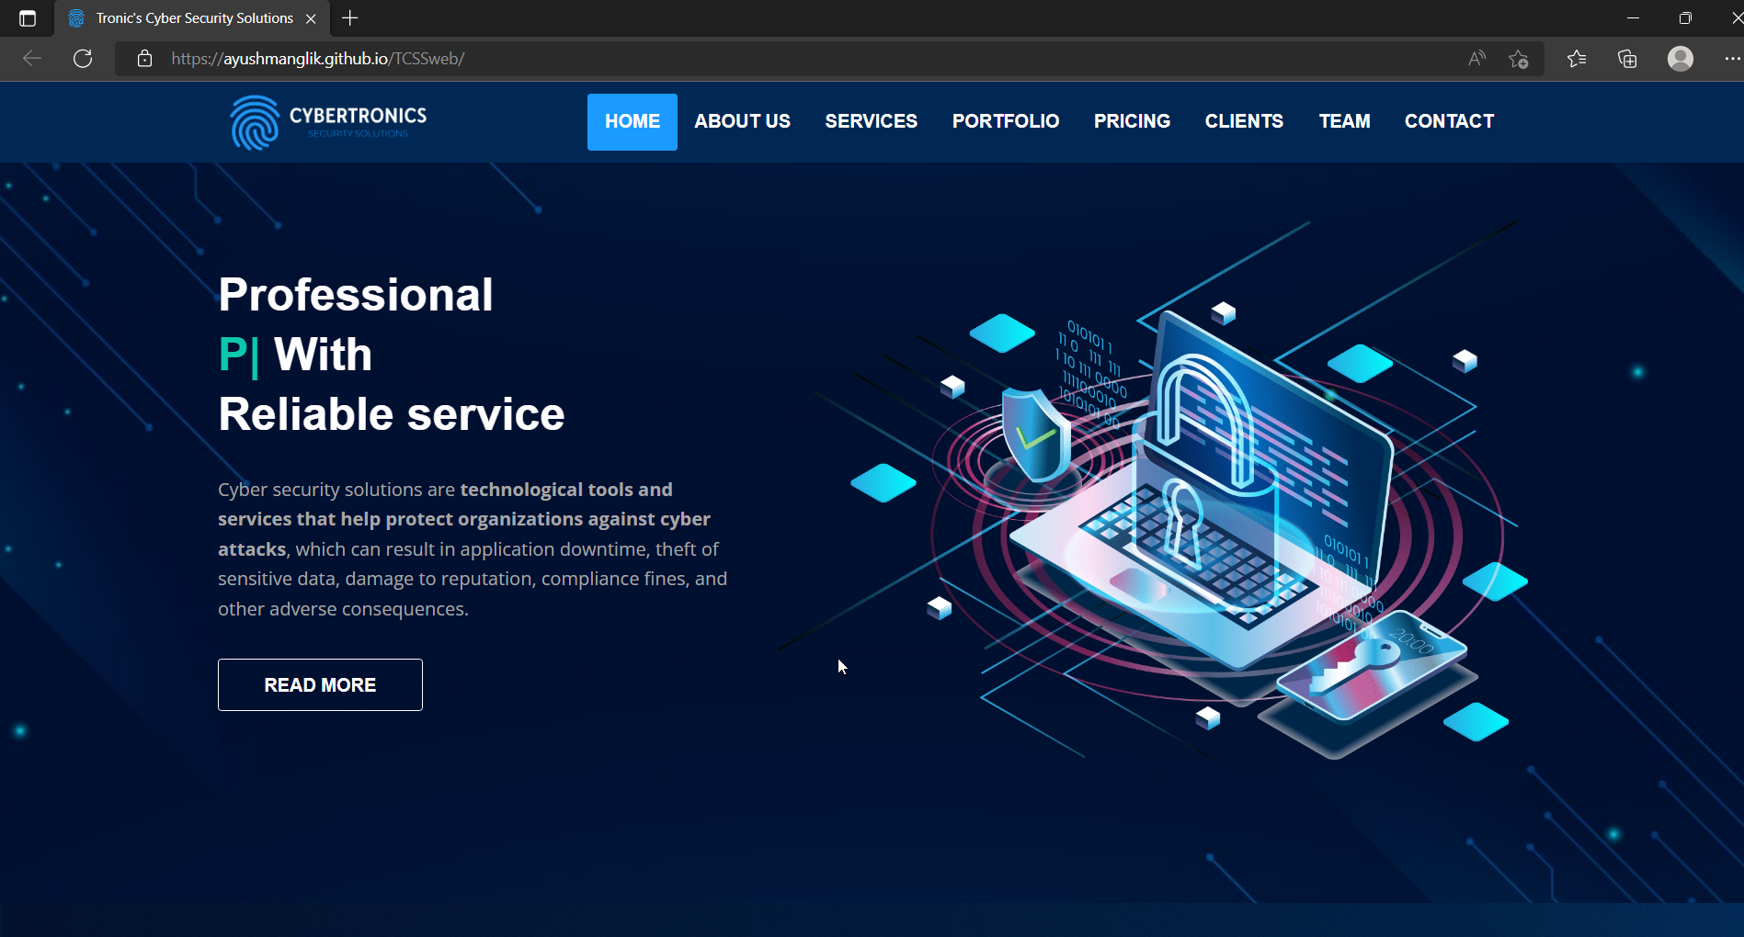
SNEAK PEEK
TEXT
HEADER
SLIDER
Button

Slide 7
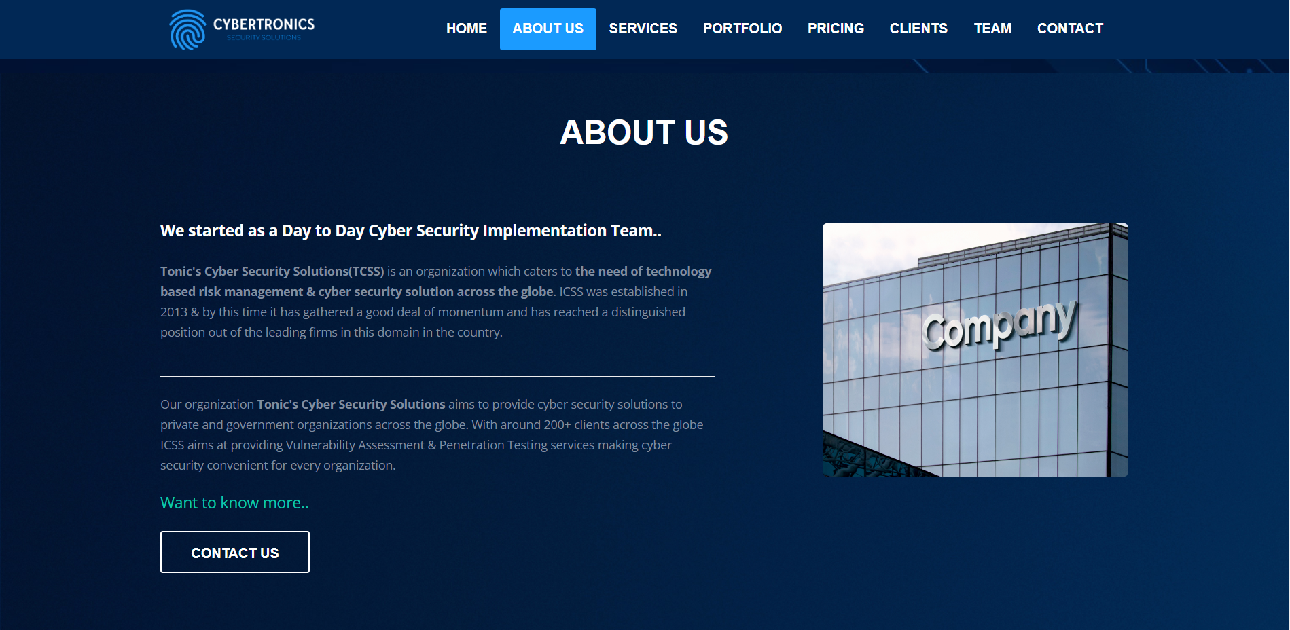
SNEAK PEEK

Slide 8
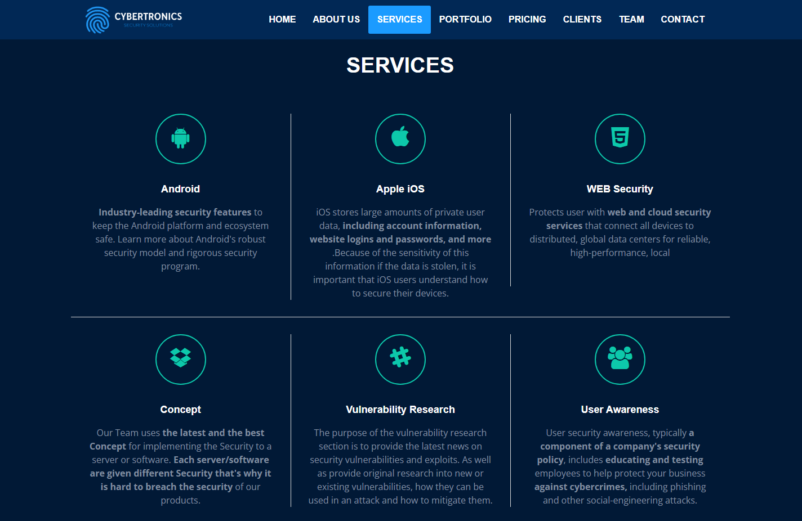
SNEAK PEEK

Slide 9
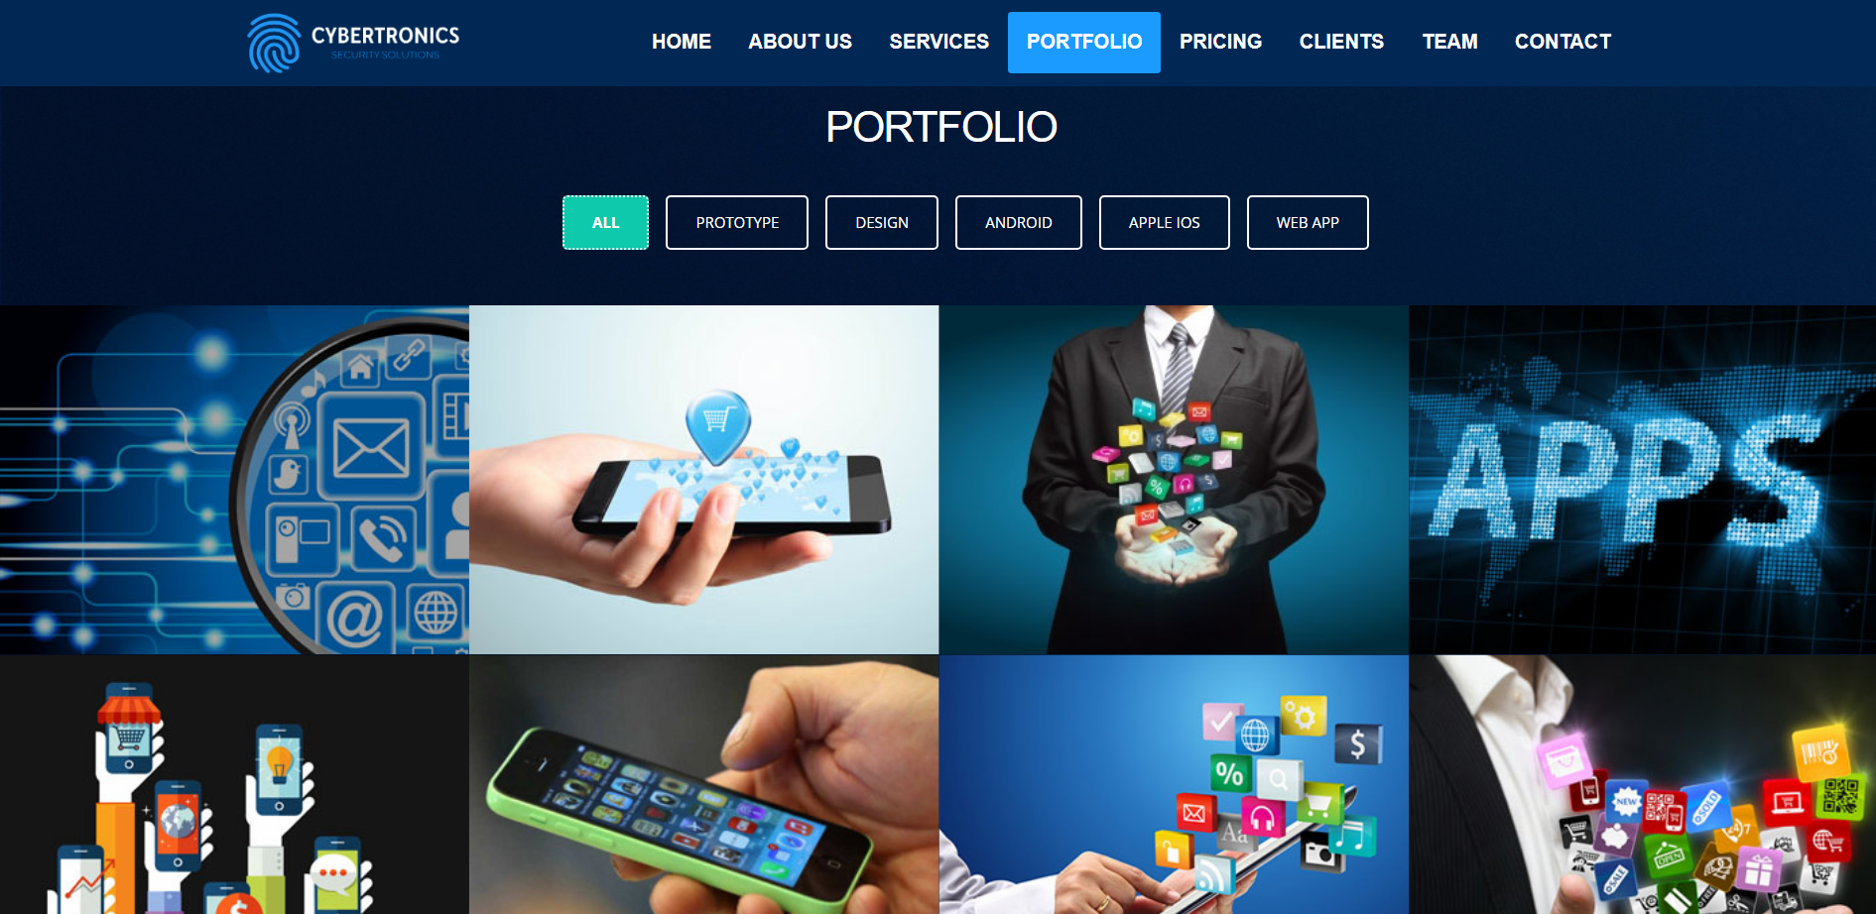
SNEAK PEEK

Slide 10
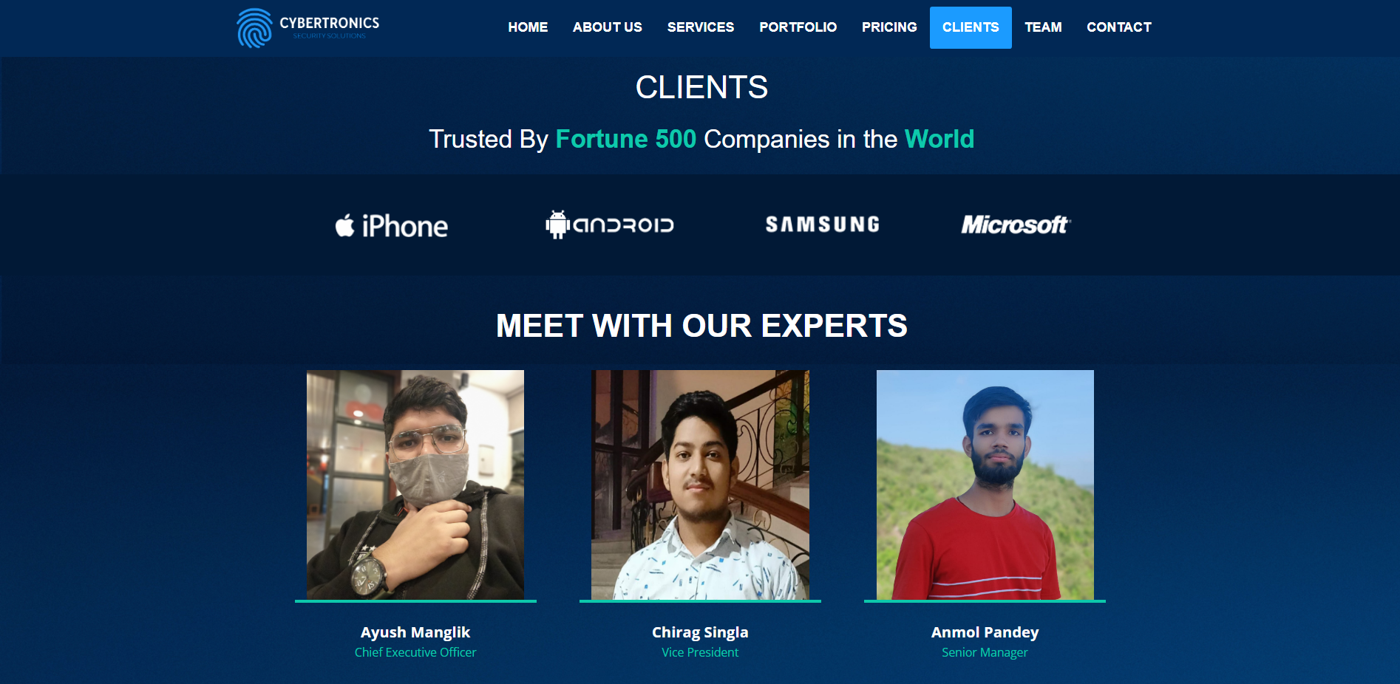
SNEAK PEEK

Slide 11
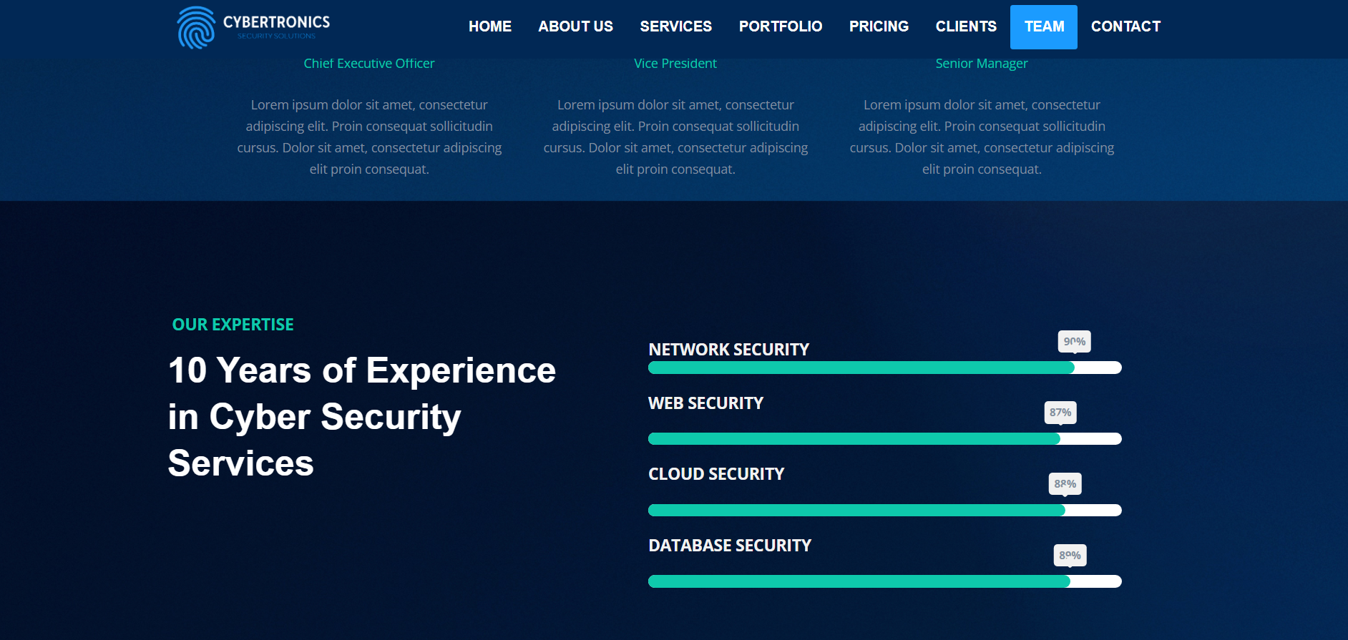
SNEAK PEEK

Slide 12
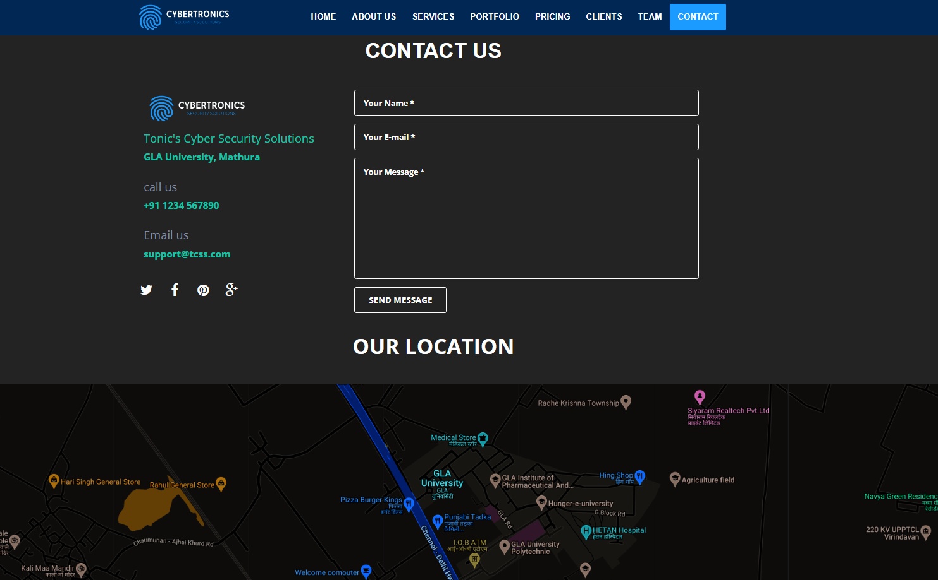
SNEAK PEEK

Slide 13
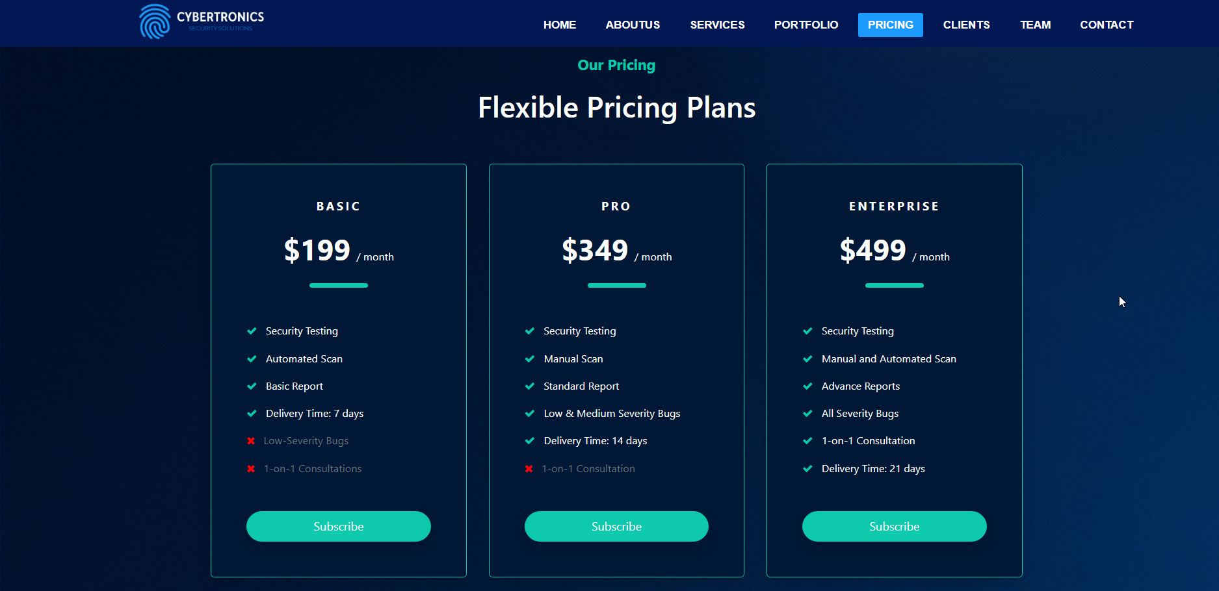
SNEAK PEEK

Slide 14
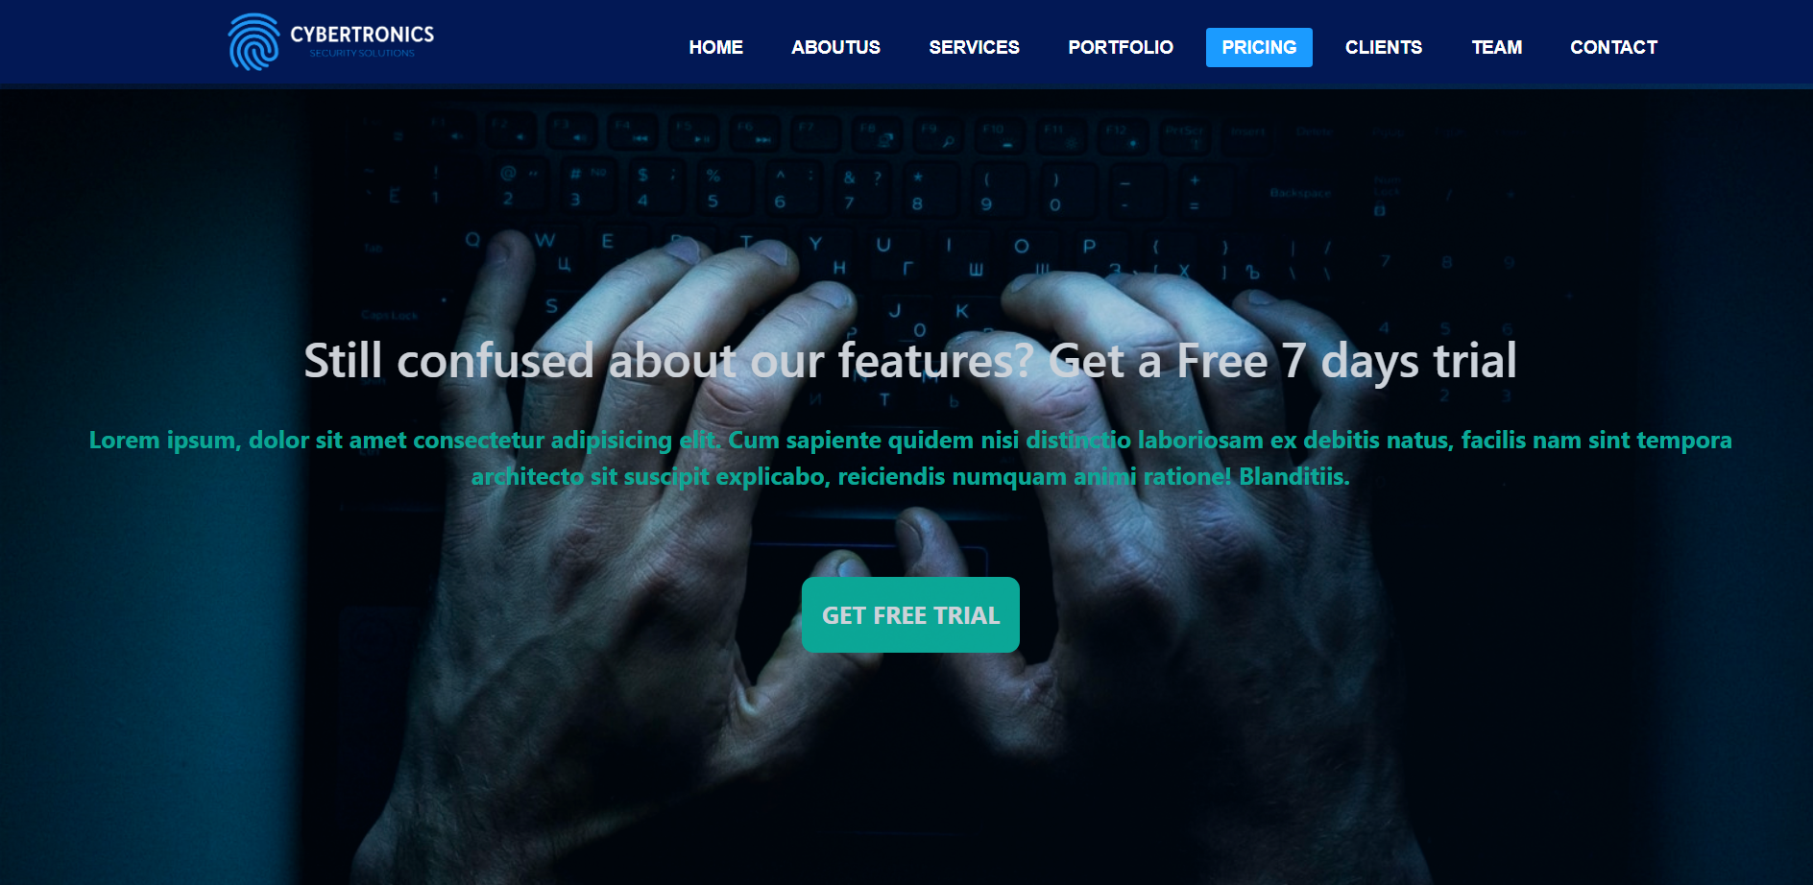
SNEAK PEEK

Slide 15
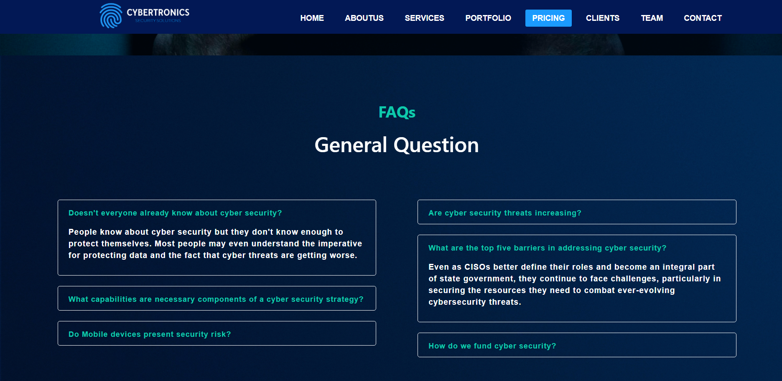
SNEAK PEEK

Slide 16
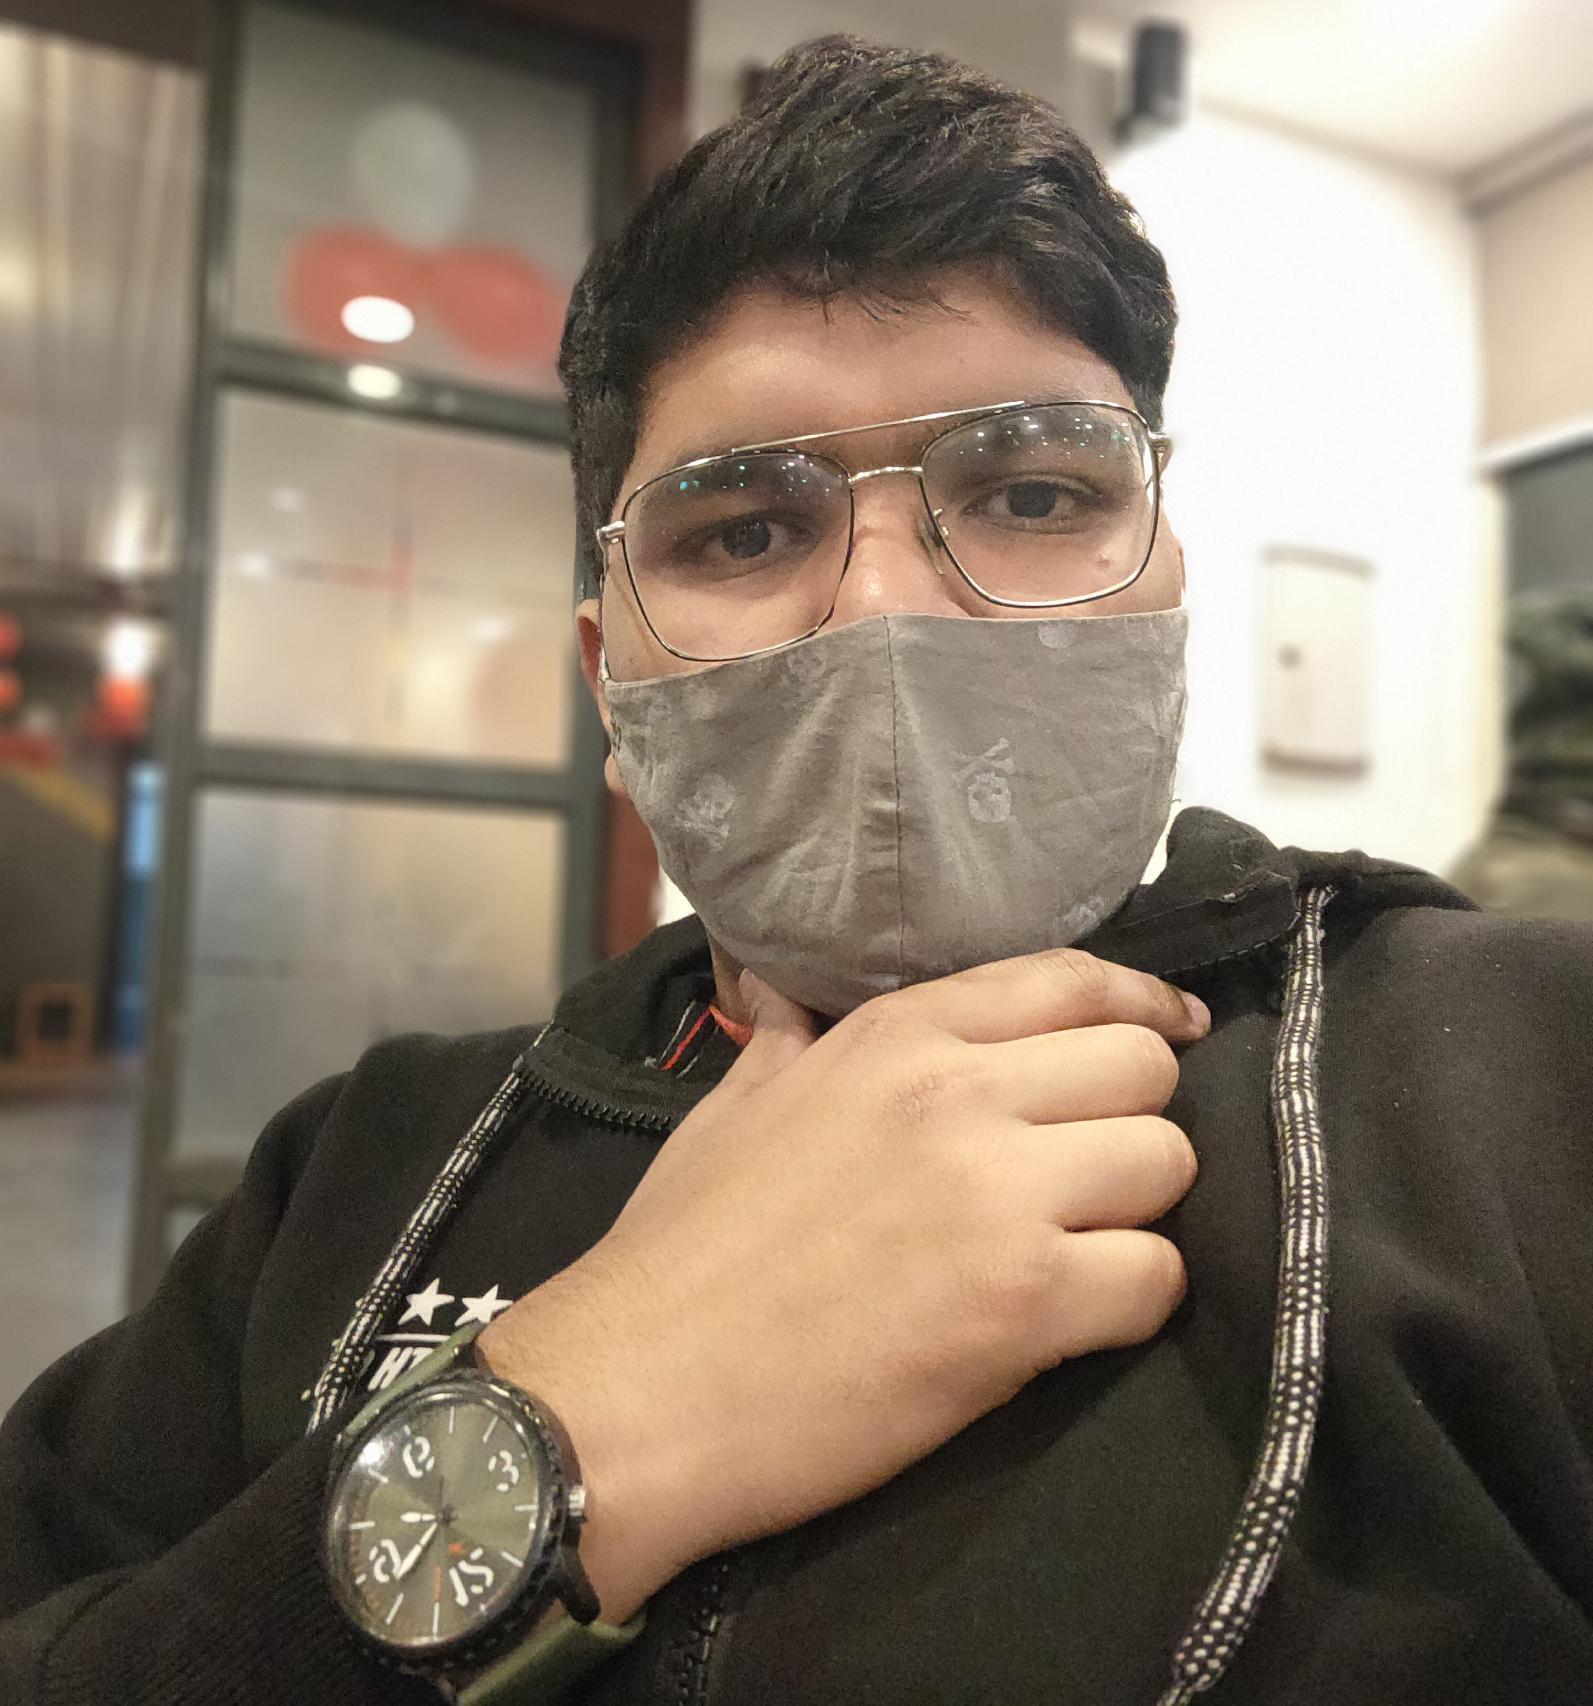

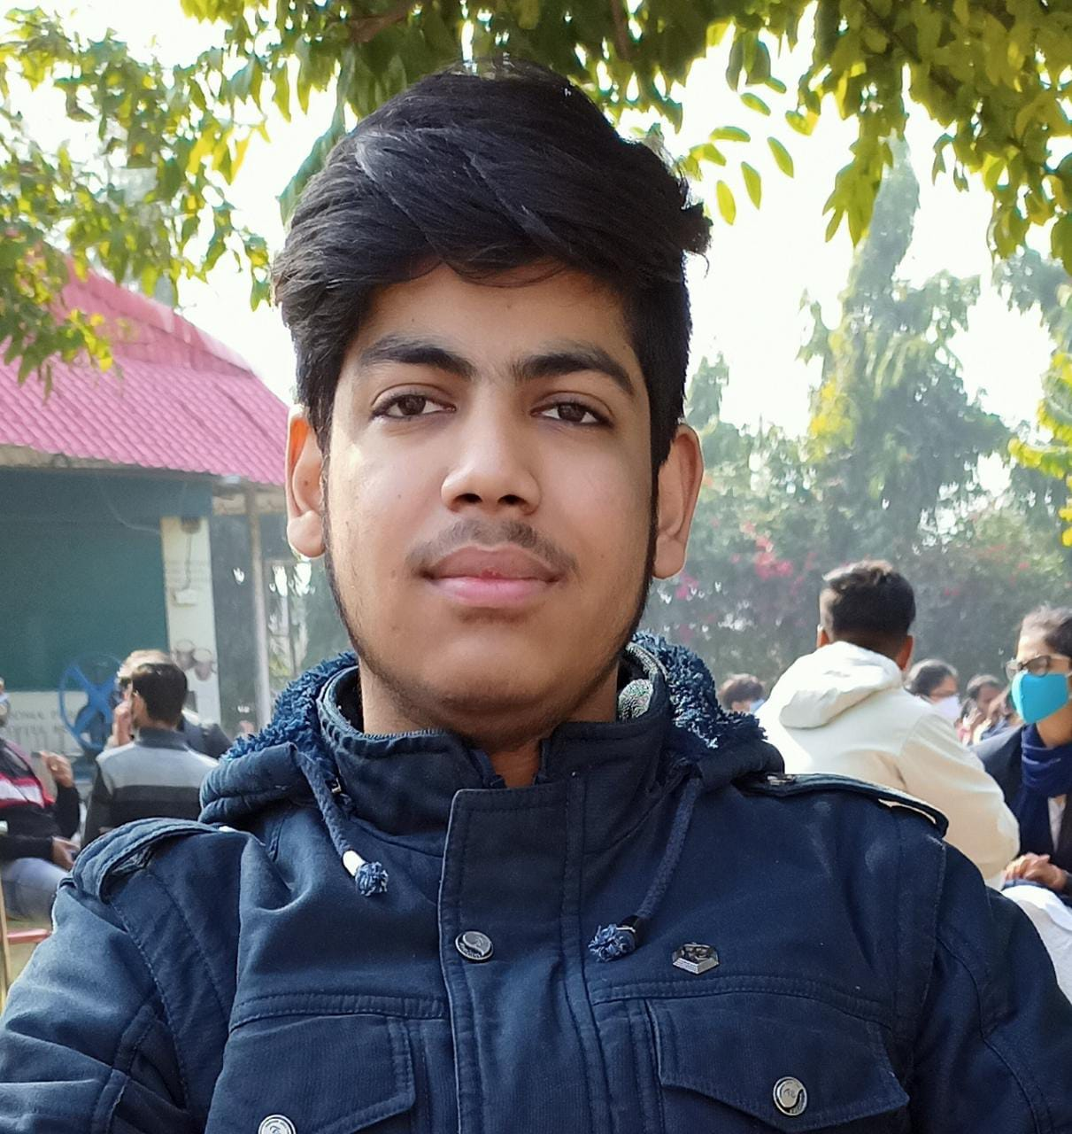



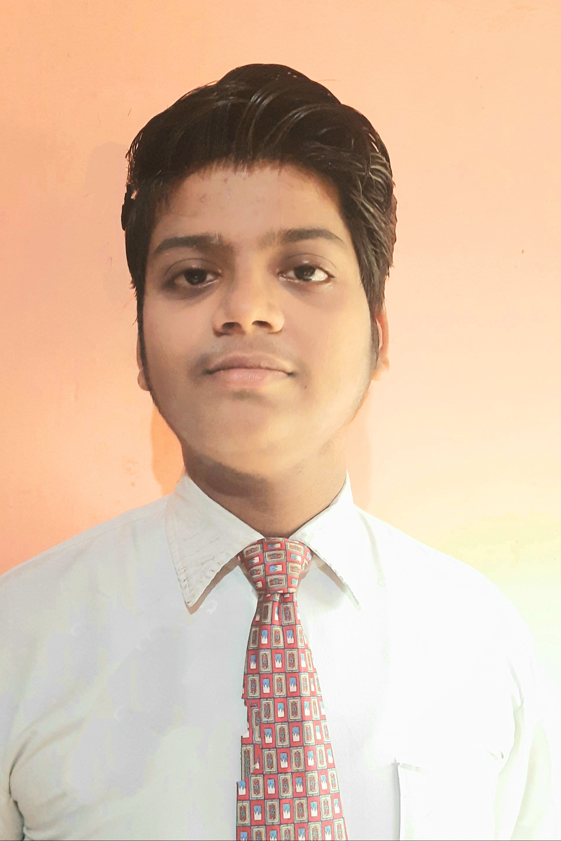
THE TEAM
Ayush Manglik Aagat Singh Anmol Kumar Pandey Anubhav Raj Chirag Singla Chirag Garg Chirag Aggarwal Sarthak Gupta Utkarsh Pranav Vikas Bansal Vaibhav Sharma

Slide 17
THANKS!

